Slide 1
Discussions on Client-side Query Processor
Yupeng Fu

Slide 2
Where are we
A GWT API for Indexeddb via JSNI
An Indexeddb Execution module that performs operations
SchemaObject and Tuple in JS using JavaScript Overlay
An Indexeddb data source that
Introspects schema
Create schema object
Set data object 150tuples in 1000ms
Execute plan

Slide 3
Indexeddb APIs
Synchronous APIs
Designed for HTML5’s worker thread
Not implemented by any browser
Asynchronous APIs
All operations immediately return an IDBRequest instance
interface IDBRequest : EventTarget {
readonly attribute any result getraises (IDBDatabaseException);
readonly attribute unsigned short errorCode getraises (IDBDatabaseException);
readonly attribute Object source;
readonly attribute IDBTransaction transaction;
readonly attribute unsigned short readyState;
attribute Function onsuccess;
attribute Function onerror; };

Slide 4
Asynchronous Programming
Create IndexedDB Sample – With Synchronous API
function create_openDB()
{
try
{
var db = window.indexedDBSync.open(indexedDBName);
if (db)
{
db.setVersion("1.0");
PrintDBInformation(db);
db.close(); 11: }
}
catch (e)
{
output_trace("Error: " + e.message);
}
}

Slide 5
Asynchronous Programming
Create IndexedDB Sample – With Asynchronous API
function create_openDB()
{
try {
var dbreq = window.indexedDB.open(indexedDBName);
dbreq.onsuccess = function (event) {
var db = event.result;
db.setVersion("1.0");
PrintDBInformation(db);
db.close();
}
dbreq.onerror = function (event) {
output_trace(“Error: " + event.message);
}
}
catch (e) {
output_trace("Error: " + e.message);
}
}

Slide 6
Asynchronous Programming
Why Asynchronous?
JavaScript executes in single-thread
Not to block the browser
create_openDB
Indexeddb.open()
Mouse click
Mouse-click callback
Create_openDB callback
PrintDBInformation()

Slide 7
IndexeddbExecution
API
executeTransaction(String db_name,
Mode mode,
IndexeddbTransaction transaction,
Operation[] ops,
AsyncCallback<IndexeddbTransaction> callback)
public interface Operation {
public void execute(IndexeddbTransaction transaction);
}

Slide 8
Transaction Mode Issue
IndexeddbTransaction
IDBDatabase
IDBTransaction
Mode
Chain of IndexeddbDB transaction
IDBTransaction is automatically commited when the request is done
IDBTransaction cannot be nested
Reuse the transaction and set it to the most flexible mode

Slide 9
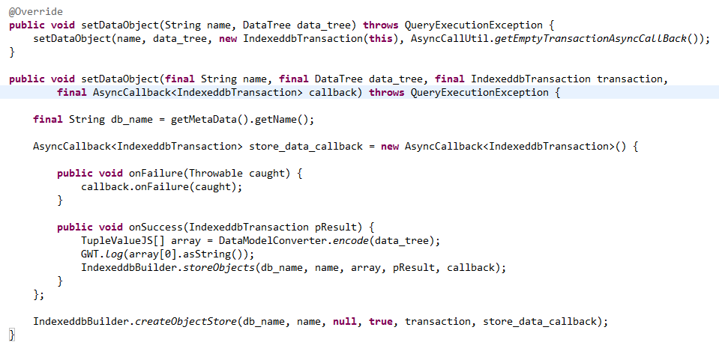
Indexedb Data Source
Asynchronous API

Slide 10
Challenge
Build the plan execution in the Async mode
Indexeddb API is asynchronous
sendPlanServer will be asynchronous
Make the asynchronous call only when necessary

